Slide 1

ON DEMAND SECURITY SYSTEM
Group-04 (UI/UX DESIGN)
COLLABORATED WITH
ADRITA RAHMAN BUSHRA 20-43367-1
MD. NAFIS ULFAT 20-42248-1
MD. MUZAHIDUL ISLAM 20-43841-2
TAZIN ALAM 20-43848-2

Slide 2
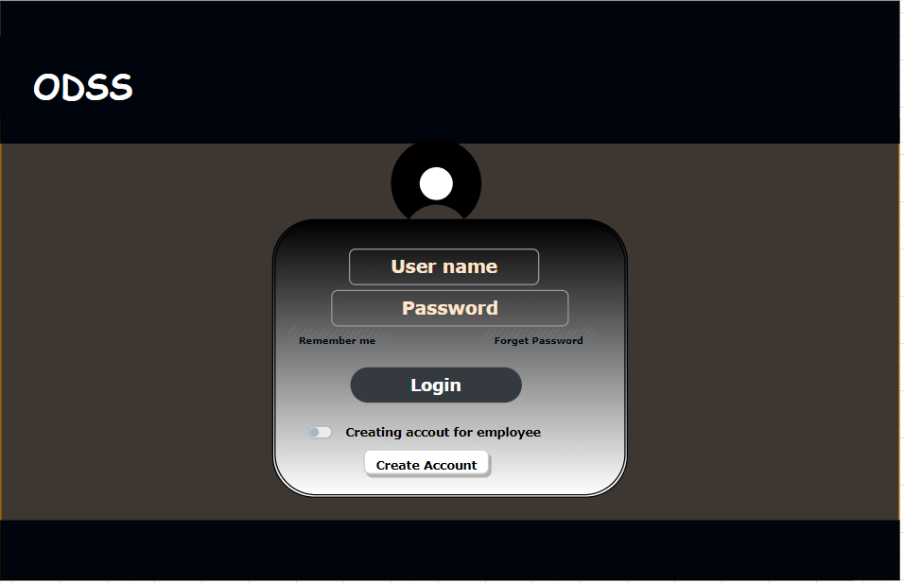
LOGIN PAGE

Slide 3
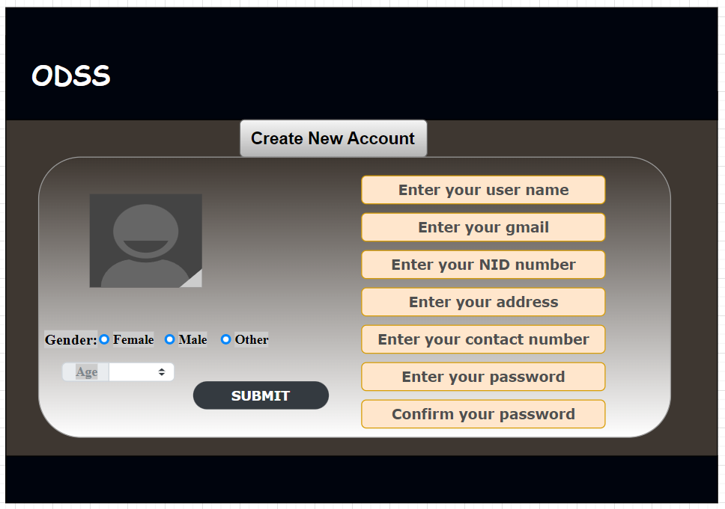
CREATE ACCOUNT FOR CUSTOMER

Slide 4
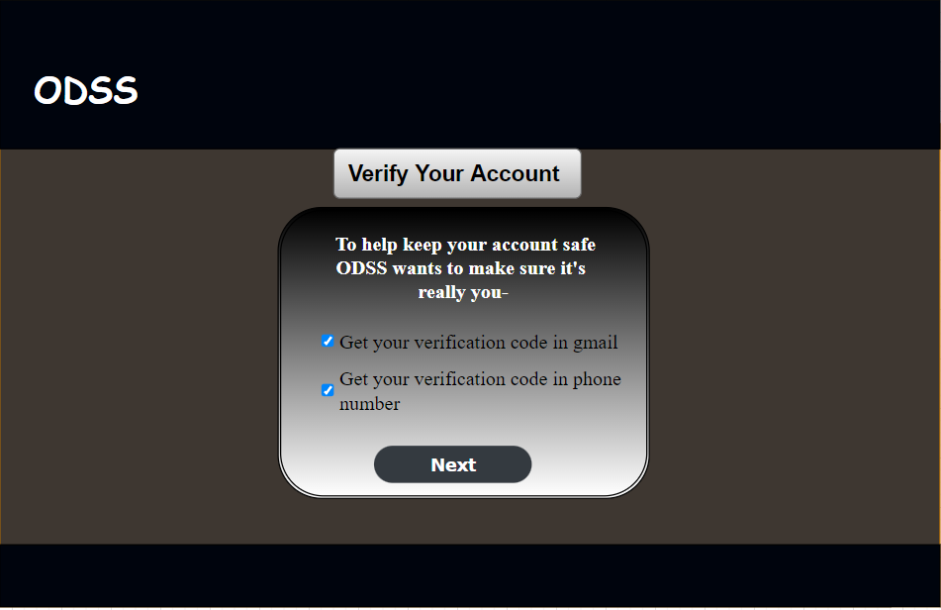
VERITICATION PAGE

Slide 5
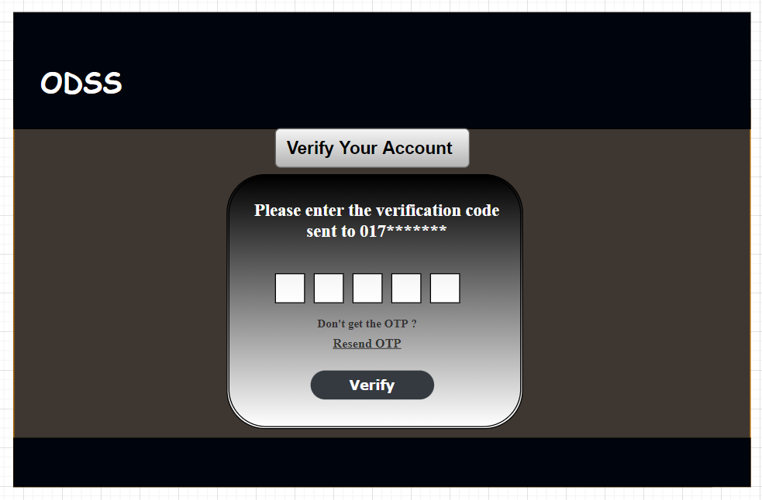
VERIFICATION CODE PAGE

Slide 6
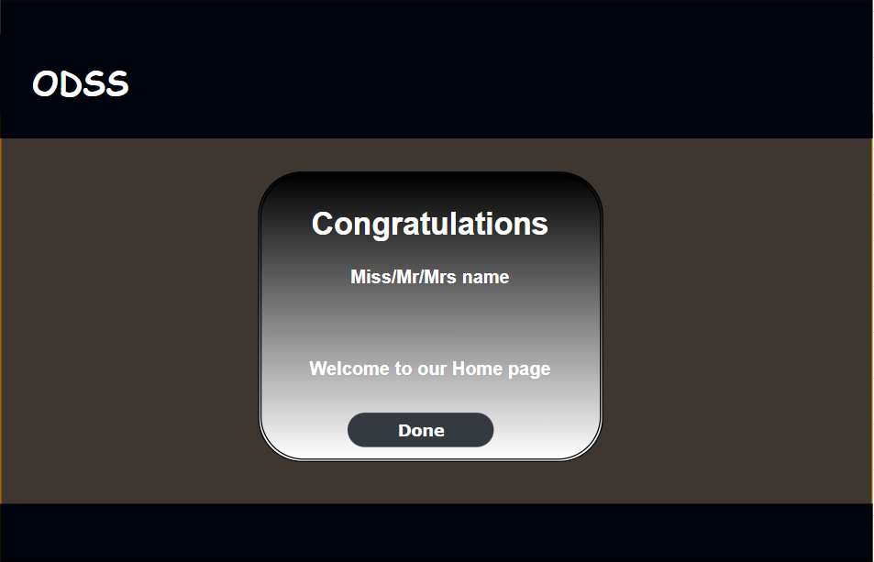
WELCOME PAGE

Slide 7
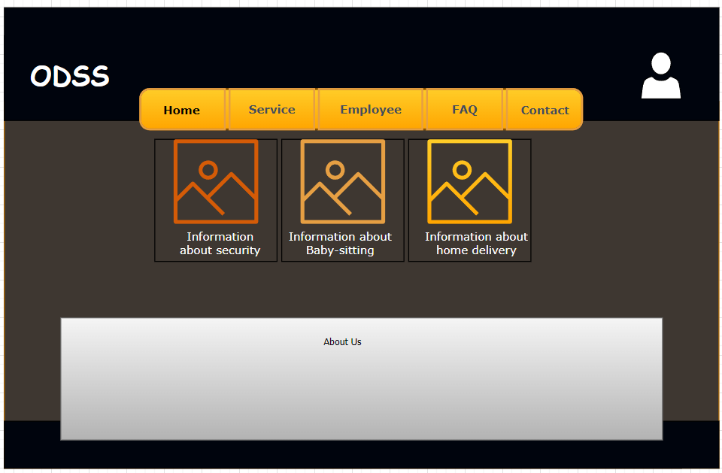
HOME PAGE

Slide 8
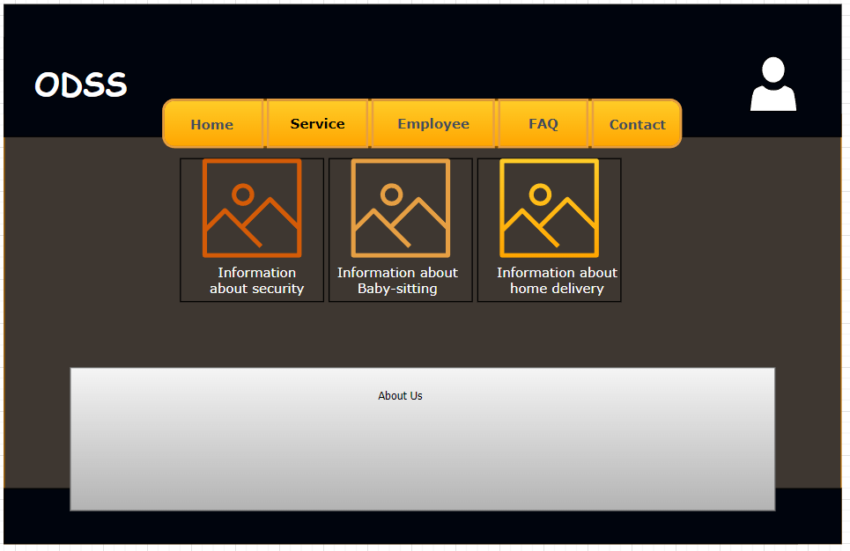
OTHER PAGE

Slide 9
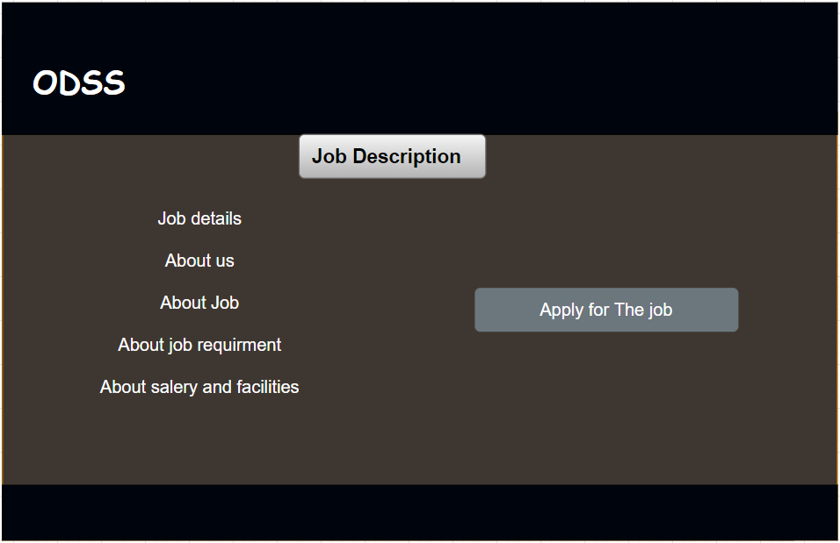
JOB PAGE FOR EMPLOYEE

Slide 10
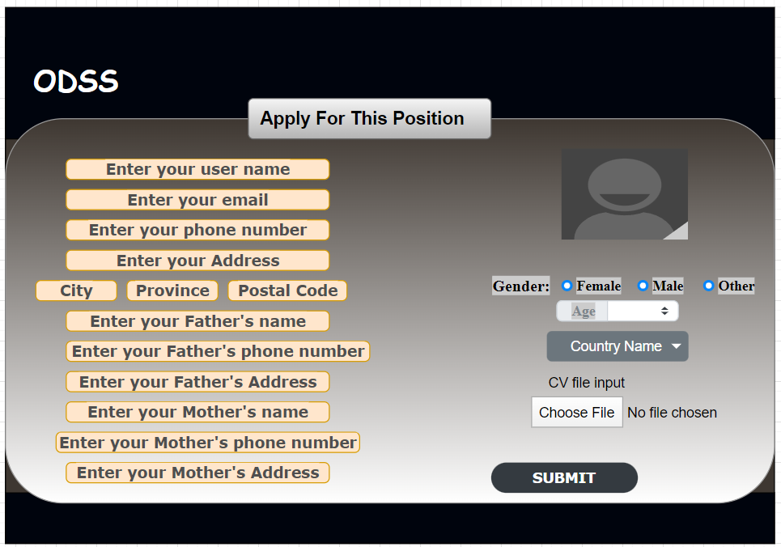
EMPLOYEE INFORMATION

Slide 11


